Slide 1
Supermarket Sales Analysis
By: Sai Keerthi Mandalapu

Slide 2

Problem Statement:
Understanding and analyzing supermarket sales data is crucial due to the increasing presence of supermarkets in densely populated cities and high market competition. The objective of this analysis is to utilize historical sales data from three branches over three months to gain valuable insights using MySQL

Slide 3
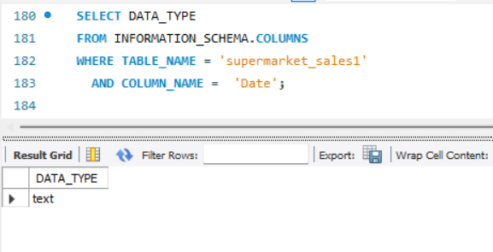
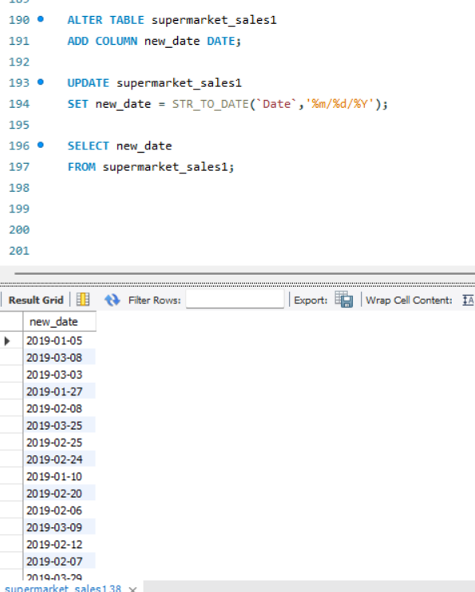
This query changes the data type of the 'Date' column from text to date format, which is essential for accurate date-based analyses..

Slide 4
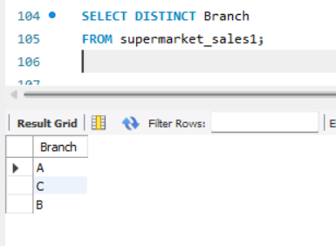
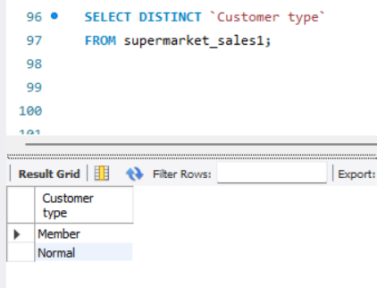
This query retrieves the unique branches present in the dataset.
This query retrieves the unique customer types present in the dataset.

Slide 5
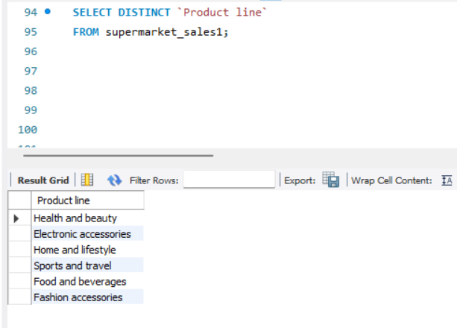
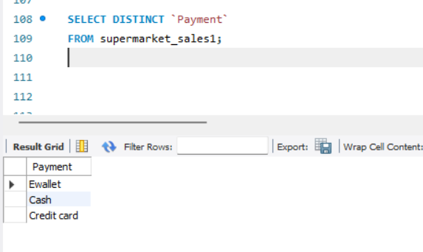
This query identifies the distinct product lines present in the dataset.
This query retrieves the unique payment methods used by customers in the dataset.

Slide 6
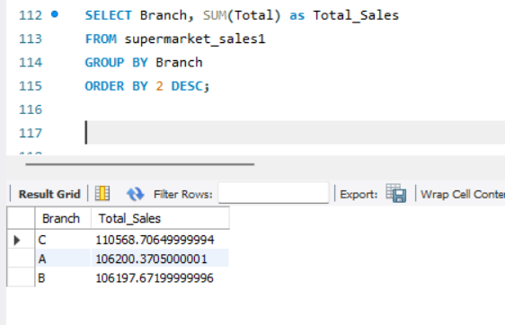
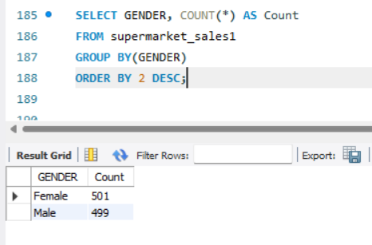
This query calculates the total sales generated by each branch.
This query counts the number of customers categorized by gender.

Slide 7
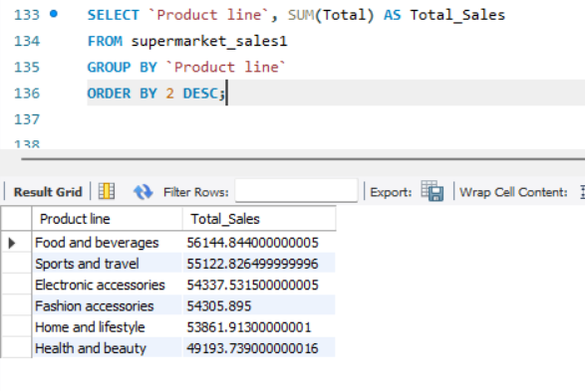
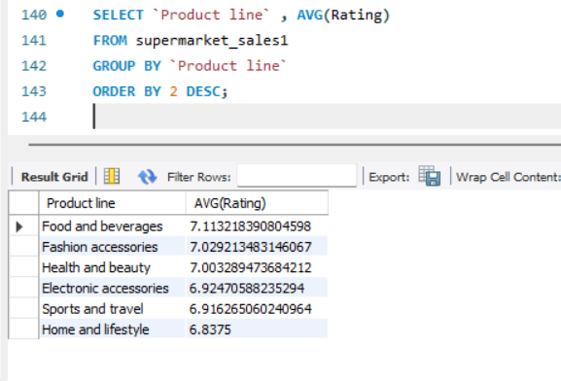
This query calculates the total sales for each product type.
This query calculates the average rating for each product line.

Slide 8
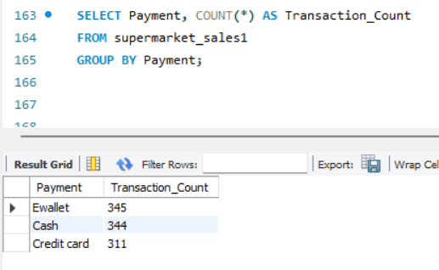
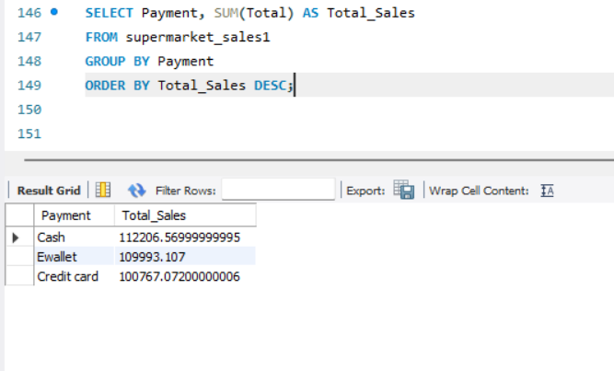
Query to obtain number of Transactions made using each payment type.
Query to obtain total sales categorized by each payment method.

Slide 9
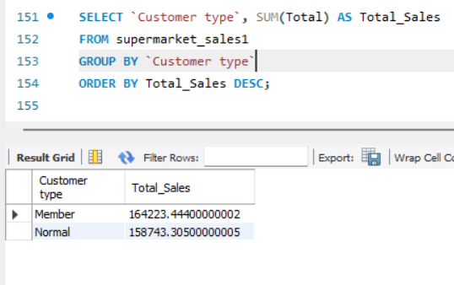
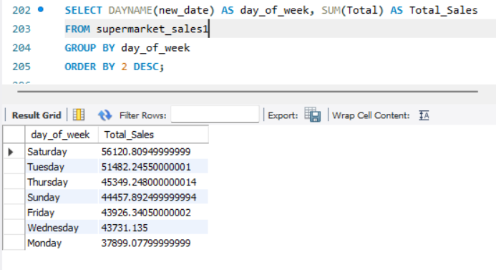
This query calculates the total sales grouped by each customer type.
This query calculates the total sales obtained on each day of the week.

Slide 10


